Slide 1
SOLA
Calgary’s Leading Real Estate Investment Opportunity
www.solacalgary.com

Slide 2
SOLA in Kensington
SOLA Modern
Luxury collection of 172 beautifully designed smart homes, with efficient trendy floorplans.
Roof top amenities such as state of the art fitness centre & cool penthouse terrace lounge, a pet spa for all residents, and much more.
SOLA You
SOLA in Kensington will offer leading tech features in Canada for every smart home resident.
1st of its kind in Calgary for any new luxury condo building.
Higher level of safety, ease, & comfort.

Slide 3
Ocgrow Group of Companies
For over 30 years, Ocgrow Group has been consistently growing our investment portfolio of real
estate assets across Western Canada.
Ocgrow Group is a privately held, diversified investment group of companies, involved in all aspects of investment, development & management of real estate.
Ocgrow is also involved in venture capital industry for over 25 years, focused on the technology
sector and related high growth investment opportunities for its private equity fund.
SOLA is Ocgrow’s latest visionary project, which is over six years in the making & our vision was to create Canada’s leading innovative new tech mixed use project here in Calgary, which our entire community can all be so proud of for years ahead.
Ocgrow Group of Companies

Slide 4
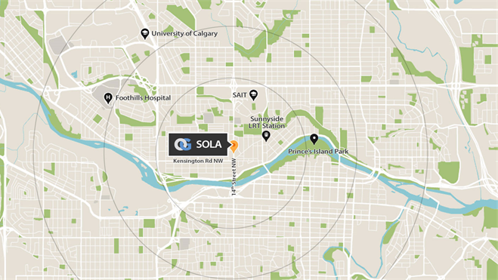
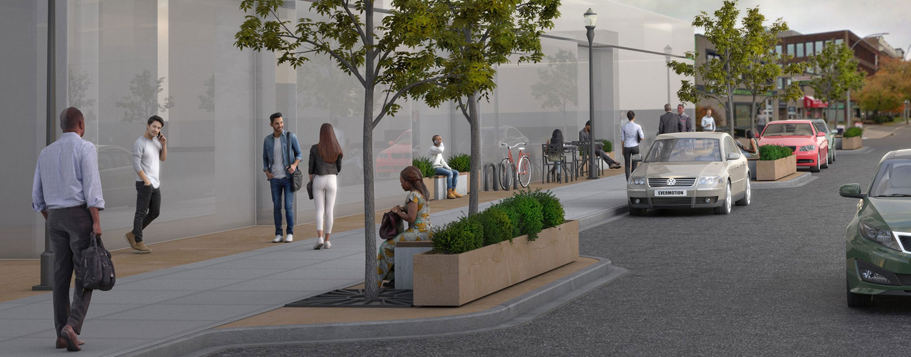
SOLA Central
SOLA in Kensington lives at the intersection of everything you need; Whether you’re headed downtown for work, hopping the train to U of C, studying at SAIT, headed for a run or bike ride along the river, going out for coffee or drinks with friends, you’re always just a few short blocks away.

Slide 5
Why Calgary?
Voted #1 most Livable City in Canada and #1 most Livable City in North America
Most affordable living costs for any major metropolitan centre in Canada
Solid population growth for years ahead, both from interprovincial migration & international immigration into Calgary
Pro-business economy & friendly low tax business climate to promote growth
Multi-cultural community & youngest demographic population in Canada
Huge tech sector growth & new jobs/economic diversification is accelerating
Most attractive real estate investment cycle, with low interest rates, lower vacancy rates & rising rents ahead

Slide 6
Calgary 5th Most Livable City in the World
Voted 5th most Livable City in the World*
Highest head office concentration per capital in Canada
For 2nd year in a row, Calgary ranked top most Livable City in North America
* The Economist Intelligence Unit's Global Livability Index.

Slide 7
Continued Growth With Diversified Economy
Each year, Calgary’s economy continues to diversify and expand rapidly beyond its oil & gas industry, into so many high growth sectors:
Technology – Software, IT Services, Interactive Digital Media, etc.
Manufacturing & Distribution
Logistics & Transportation
Financial Services
Renewable Energy

Slide 8
Alberta has the Lowest Tax Rate in Canada
As of July, 2020, Alberta’s corporate tax rate is only 8%, the lowest in Canada
Alberta has one of the lowest tax rates now in North America
Alberta has no provincial sales tax
https://calgaryherald.com/news/local-news/live-kenney-to-detail-albertas-economic-reboot-plan

Slide 9
Strong Rental Demand, Lower Vacancy Rates
Solid influx of population growth
Lower Vacancy Rates for Past Several Years
Rising Rents
Lower inventory stock of housing leading to rising values over coming years
Source: CMHC Rental Markey Survey

Slide 10
Huge Growth in Calgary’s Tech Sector
Tech sector in Calgary growth is fastest growing job creator, with global investors accelerating tech investments
Global software development company ESQ Business Services selected Calgary, as Canadian head office
Calgary based Symend raised over $70 million in May, 2020 & hiring every week
Attabotics raised over $50 million in August, 2020 & expanding rapidly
Benevity software headcount over 600 now, with major growth ahead
Shareworks by Morgan Stanley (formerly Solium) continues headcount expansion
So many other high growth tech companies, expanding offices into Calgary
https://calgaryherald.com/opinion/columnists/varcoe-tech-sector-gets-more-traction-in-calgary-as-big-investors-target-attabotics/wcm/24bd8294-f4bc-4cd1-aa9d-209d3b8d8fc6/
https://dailyhive.com/calgary/global-software-development-company-calgary

Slide 11
Global Tech Companies Expanding Into Calgary
Absorb Software, learning technology firm with global offices, just leased over 80,000 sf in new Telus Sky bldg.
Greengate building Canada’s largest solar farm near Calgary, with recent $500 million investment from Denmark based investment group
Recent Tech job fair has record turnout with 2000+ jobs currently open, with huge number of new technology companies announcing Calgary expansion plans
Blacksquare, a global DTC company expanding into Calgary
Kudos, employee recognition software company continues with Calgary expansion
https://calgaryherald.com/business/local-business/greengate-secures-partner-to-finance-countrys-largest-solar-project
https://calgaryherald.com/business/local-business/local-tech-sector-hosts-hiring-fair-more-than-300-jobs-available

Slide 12
Rocky View County’s Explosive Growth
Rocky View is part of Greater Calgary, & has averaged annual growth rate of 9.5% and expected to continue for years to come
Greater Calgary is becoming Western Canada’s leading logistics and distribution hub, for all major North American companies expanding.
Several major North American companies have expanded into the region including Amazon, Home Depot, CHEP Canada, Lowe’s & many more.
Since 2016, the region has attracted over seven million square feet of distribution centre & e-commerce fulfillment centre tenants, and Greater Calgary’s growth is accelerating.

Slide 13
Why SOLA?
Most tech innovative new multi-family building in Canada
Outstanding location in trendy Kensington area of NW Calgary
Walking distance to all transit, parks, waterfront paths along Bow River, amenities, and closest access to UofC & SAIT, etc.
Smaller suite sizes, for affordable condo unit prices for any new Calgary project.
1 year of Free Gigabit Ethernet for all residents, FASTEST Internet in Alberta
SOLA smart hub built into every single luxury residence, with Canada’s 1st Amazon Alexa enabled building.
Roof top fitness centre, penthouse terrace lounge, cool pet spa in building & so much more!
Incredible views from upper floor units
Exceptional Investor Program, with full rental management services available.

Slide 14
Investment Rental Analysis
Revenue
Avg Monthly Rent | $1,512.00
Monthly rent/psf | $3.50
Monthly Revenue | $1,512.00
Expenses
Monthly Principal & Interest Payment | $924.45
Condo Management Fee | $203.46
Property Taxes Monthly | $157.28
Insurance
Monthly Expenses | $1285.19
Net Profit
Monthly Cash Flow | $226.81
Annual Cash Flow | $2,721.72
Total Annual Cash Flows
Year 1 | $2,721.72
Year 2 | $2,857.81
Year 3 | $3,000.70
Year 4 | $3,150.73
Year 5 | $3,308.27
Market Assumptions
CMHC Guidelines
5% Annual Rent Increase
5 Yr, 30 Yr Amortization Mortgage at 2.0%
City of Calgary Estimated Property Taxes
Condo Fees/Insurance Estimates Only
Cabriola
Size (sf) | 432
Type | 1Bed
Purchase Price | $298,080
GST | $14,904
Total Price Including GST | $312,984
Down Payment (20%) | $62,597
Mortgage Amount | $250,387

Slide 15
Calgary is a Pro-Business Economy
Its crystal clear, that Calgary has the lowest tax rate & most pro-business economy, with regards to rental investment property, when compared to Canada’s other major markets:
RENTAL PROPERTY INVESTMENT TAXES
City | Property Tax | Vacancy Tax | Foreign Buyers Tax | Rent Control | Notice of Rent Increase
Vancouver | YES | YES | YES | YES | 3 MONTHS
Toronto | YES | ZERO | YES | ZERO | 3 MONTHS
Calgary | ZERO | ZERO | ZERO | ZERO | 3 MONTHS

Slide 16
Property Management Program for Investors
SOLA has a complete property management for our investor clients
Includes full rental management, lease-up to best tenants, complete Landlord/Tenant documentation, monthly reporting & all deposits to owners’ accts, etc.
Always focused on achieving highest ROI for investors, with peace of mind, professional management
Full condo/strata management in place & property management discounts available for investors with multiple units

Slide 17
Welcome to
SOLA
www.solacalgary.com
info@solacalgary.com

